Slide 1
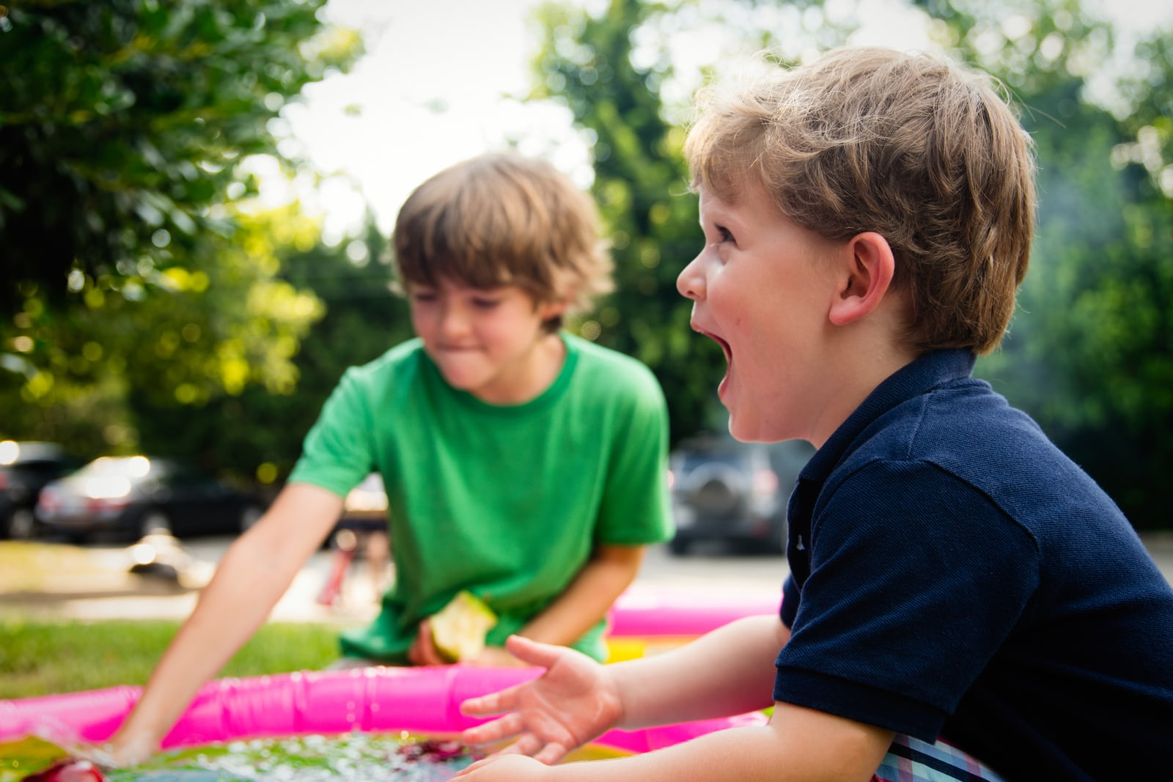
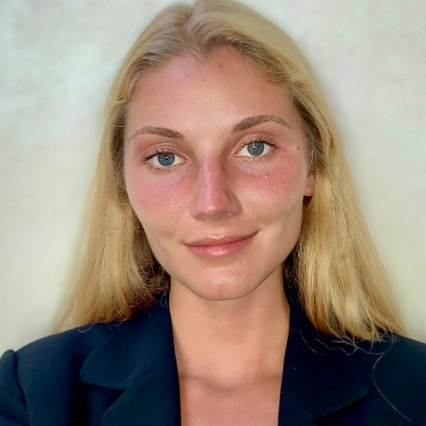
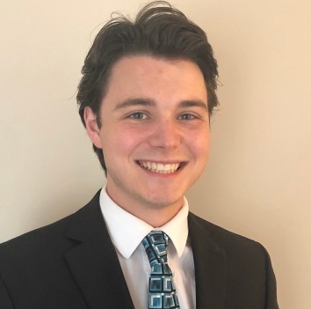
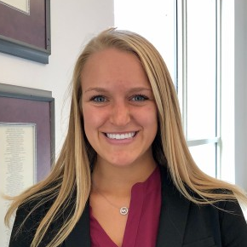
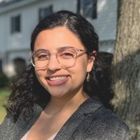
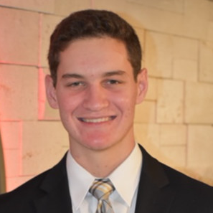
main
Pt 1
Pt 2
Pt 3
accent
accent
accent
Variety: The Children’s Charity
Mary
Kate
Anna
Jacob
Tara
Robbie
9 October 2020
These slides were part of an oral presentation by Anna Berry, Jacob Herbert, Mary Kate Kellock, Tara Layous, and Robbie Levine for J420. They are not a complete record of that presentation, nor of the accompanying discussion. The slides are protected by copyright law and may not be reproduced, in whole or in part, without the express written consent of the author.

Slide 2





main
Pt 1
Pt 2
Pt 3
accent
accent
accent
Variety’s low awareness and limited branding leads to a lack in recurring
donations and brand loyalty
“While Variety has a broad set of fundraising activities, it does not currently have a targeted approach for seeking recurring personal donations.”
52%
More people know about Variety from their Bash event than their charity work
Grants
Programs
Wasting resources on not knowing who to target
Services
Scholarships
Kids Events
Branding does not reflect its core activities
Source: Variety Case pg. 5
- 1 -
Notes:
Low awareness – only comes from Bash event
Use the stat that most people know them from the Bash
Want to generate recurring donations
Do not communicate value of organization and do not have steady stream of donations
Unsure of their target groups
Branding is not targeted and need to know who exactly to target

Slide 3



main
Pt 1
Pt 2
Pt 3
accent
accent
accent
Variety should target young families via improved marketing channels to
participate in the “Nice to Meet You” Campaign
Who
What
Target young families
Host an annual event to increase brand awareness
How
Launch a marketing campaign to create recurring donations
Young families easily connect to the cause
)
Highlights Variety families
Promotes continual interaction
Families donate 23% more than non-families
Connects donors with Variety’s mission
Reaches 90,000 individuals
Young families have lowest awareness yet highest receptivity
Revolves around Variety’s values
Email subscription service increases recurring donations
- 2 -

Slide 4
main
Pt 1
Pt 2
Pt 3
accent
accent
accent
Targeting Young Families
- 3 -

Slide 5

main
Pt 1
Pt 2
Pt 3
accent
accent
accent
Variety should target young families in their 30s because they donate more
and they are close to the cause
Case Info
Analysis
Donor Timeline
Age Group | Average Donation Size | Annual Donation Amount | Potential Retention Time | Empathy with Cause | Stability
Under 30 | $38 | $147
30-40 | $45 | $226
40-50 | $49 | $279
50-60 | $49 | $324
Over 60 | $55 | $425
Young Professionals
Established Professionals/Families
Increasing stability
Families donate
23% more
than non-families
Young Families
Income, donation size rise
Least Favorable
Favorable
Who
What
How
Source: Variety Case pg. 12, 19
Assumptions: Stability generally increases as people age. People are more empathetic with those who are most like them
- 4 -

Slide 6
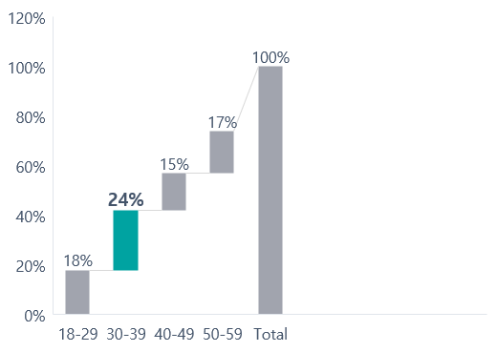
main
Pt 1
Pt 2
Pt 3
accent
accent
accent
The young families segment shows significant growth potential for Variety
to expand
Donors under 40 combine lowest awareness of Variety with highest receptivity
Age Breakdown of Potential Donors in NSW and ACT
65%
Of Australian Adults are Parents
100% = ~6.5 Million People
30-39-year-olds are by far the largest 10-year segment
840,000
Potential new donors in target market
Who
What
How
Source: Variety Case pg. 10, 19
- 5 -
Notes:
.24

Slide 7
main
Pt 1
Pt 2
Pt 3
accent
accent
accent
Variety Goes Wild
- 6 -

Slide 8

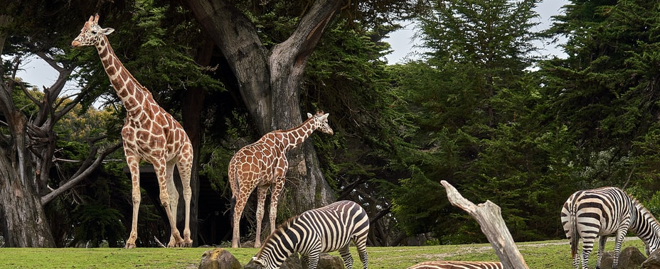
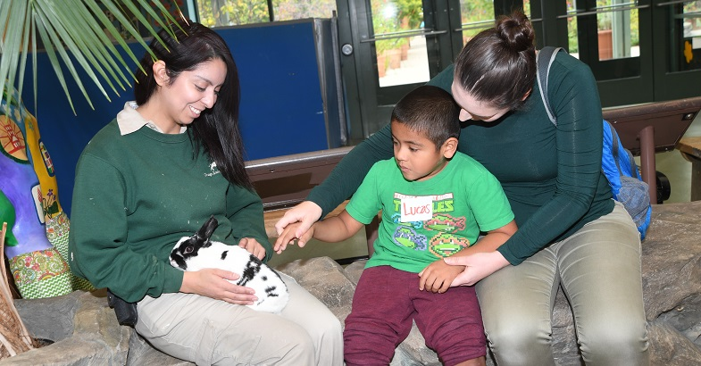

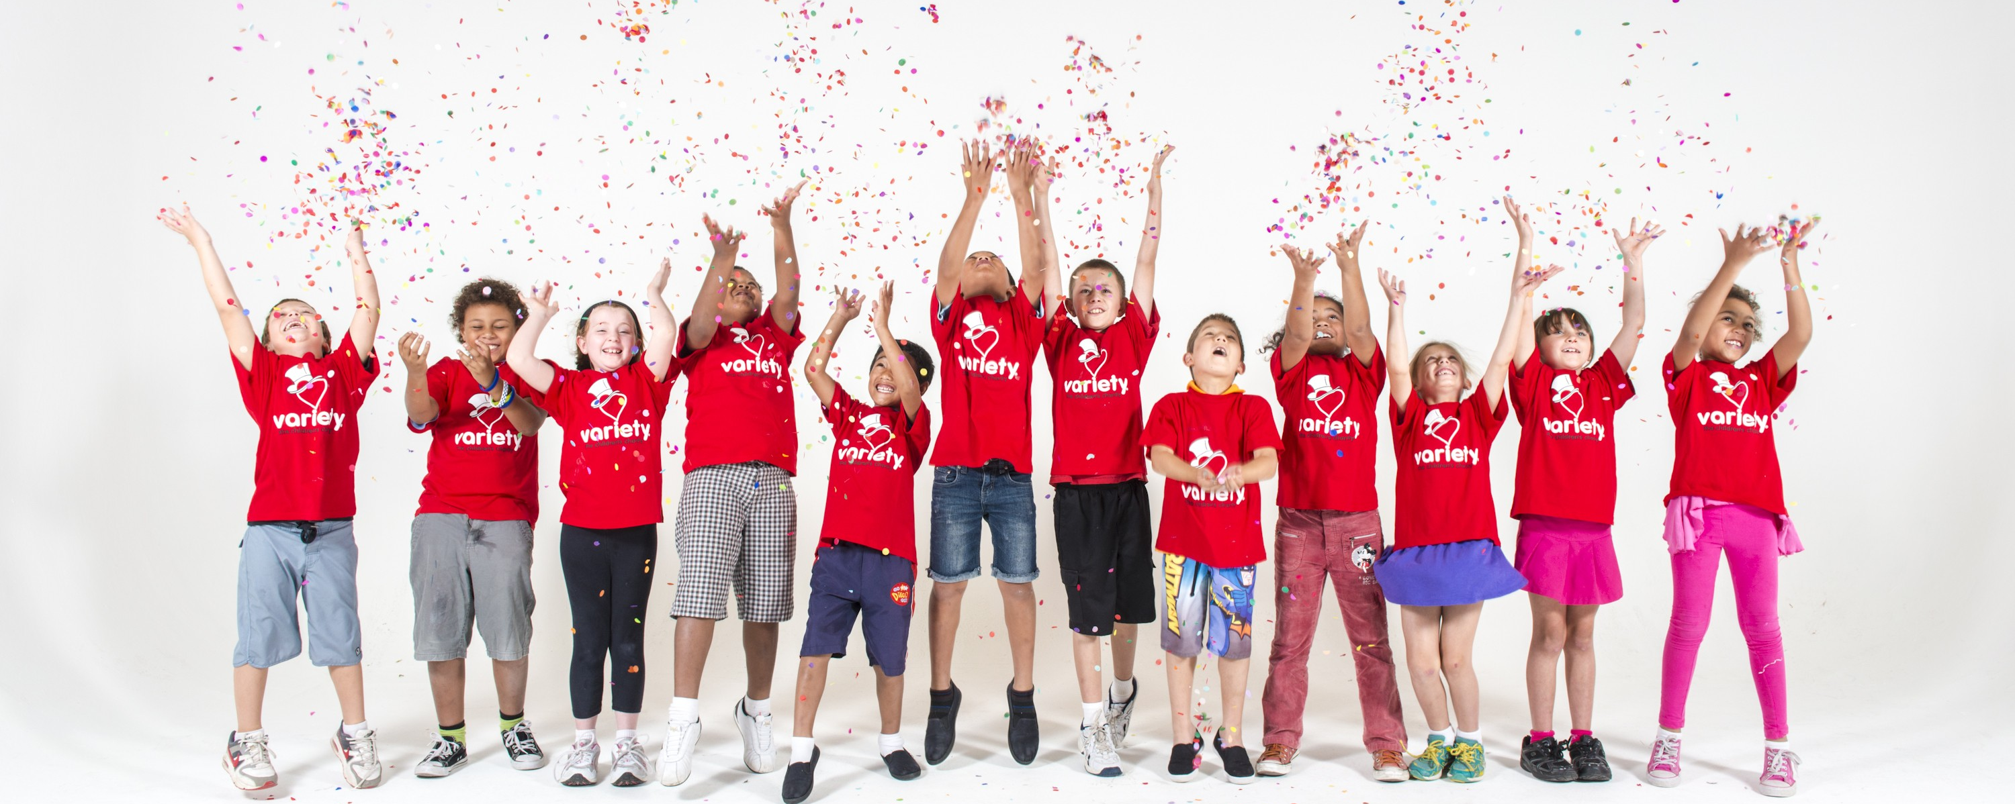

main
Pt 1
Pt 2
Pt 3
accent
accent
accent
Variety should host an annual event with donors and Variety families to connect donors to Variety’s mission
‘Variety Goes Wild’ Event
Relaxed
Environment
Connect donors to Variety families
Fun Activities
Opportunities to Donate
Collect in-event donations
Maintain positive relationships with existing target market donors
Taronga Zoo in Sydney
Canberra National Zoo & Aquarium
Who
What
How
- 7 -

Slide 9



main
Pt 1
Pt 2
Pt 3
accent
accent
accent
A family event centered around connecting donors to Variety families brings Variety’s values to life
Equality
Community
Provide an environment and activities where all children can interact
=
Create a sense of community by bringing donors and Variety families together
Action
Joy
Encourage action from donors by connecting them to the families Variety serves
Promote family fun in a relaxed and exciting environment
Who
What
How
Source: Variety Case pg. 4
- 8 -

Slide 10
main
Pt 1
Pt 2
Pt 3
accent
accent
accent
The Nice to Meet You Campaign
- 9 -

Slide 11



By marketing the "Nice To Meet You" Campaign through social media
and quarterly emails, it will reach our target market and increase recurring donors
Preferred Engagement
"Nice to Meet You" Campaign
36%
Social Networking
28%
Sign up for a subscription of quarterly emails
Introductions to new families
Showing how your donation is directly helping a child
Emails
Words Associated
with Variety
Only
21%
"Shows me how my donation makes a difference"
Chance to meet these Variety families at the events
Who
What
How
Source: Variety Case pg. 15, 16
- 10 -

Slide 12
Through our campaign, Variety can increase awareness and turn spontaneous donors into recurring donors
Advertise event through social media channels (Facebook, Twitter, Instagram) as well as emails and flyers
1
Awareness
Interest
Promote interest by connecting potential donors to our mission when they learn about Variety family stories
2
The chance to meet a Variety kid to see the impact your donation is making
3
Credibility
Brand awareness through events directed towards recurring donors as well as follow-ups to maintain participation
4
Consideration
Recurring
Donations
5
Credibility
Catalyze recurring donations because they donated 6x more than the average spontaneous donors and increase lifetime value
Who
What
How
Source: Variety Case Pg. 10, 12
- 11 -

Slide 13
main
Pt 1
Pt 2
Pt 3
accent
accent
accent
'Variety Goes Wild' and enhanced advertising increase Variety's annual revenues through a ticket sales and additional donations
From the Event:
Event Entry Ticket Price
$60/person
Revenues
Additional $10 Donation (Existing)
75%
Of 2500 pop.
We reach approximately 3,000 existing and new individuals through focused event.
Additional $10 Donation (New)
25%
Of 500 pop.
=
$66.67/person
From the Marketing Strategy:
Event Expenses (Venue, Food, etc.)
$10.50/person
Costs Acquired
+
We reach approximately 90,000 individuals through wide reaching channels like social media and email chains.
Marketing Expenses
$2.83/person
=
$13.33/person
Value
Total Gross Margin
$53/person
*Almost equivalent to the average donation of 30-39-year-old
Source: Variety Case pg. 12, 19, 20; MNZoo.org; STLZoo.org; Omahazoo.com; Themailshark.com
- 12 -

Slide 14


main
Pt 1
Pt 2
Pt 3
accent
accent
accent
Through recurring donations, Variety increases the lifetime value of its donors and events
Increase Lifetime Value of:
1
New Event – ‘Variety Goes Wild'
Avg Donation by Age | Retention | # of People
$ 45 | 1-2 years | 1,077
$ 45 | 2-5 years | 923
$ 49 | 5-10 years | 616
$ 49 | 10-20 years | 308
$ 55 | 20+ years | 154
2
Locations – Sydney (NSW) and Canberra (ACT)
The Individual by $513.40
3
Thousand people attending and donating
The Event to $1.54 million
Source: Variety Case pg. 12, 19, 20; MNZoo.org; STLZoo.org; Omahazoo.com; Themailshark.com
- 13 -

Slide 15
main
Pt 1
Pt 2
Pt 3
accent
accent
accent
Risks of the wrong target demographic, below expected revenue generation,
and fewer individuals participating can be easily mitigated
Risks
Assessment
Mitigation
The event and campaign will cannibalize other revenue-generating fundraisers
Variety can use the event and campaign as an opportunity to market and promote their other fundraisers and programs
Severity
Probability
The “Variety Goes Wild” Event does not generate as much revenue as expected
The campaign focused on improving the branding and lifetime value will yield positive returns above and beyond the event at hand
Severity
Probability
Less than 90,000 individuals are reached through the event/campaign, respectively
Because of the nature of the campaign lasting a few years, the donors reached will increase over time and yield the same recurring donations over time
Severity
Probability
- 14 -

Slide 16
main
Pt 1
Pt 2
Pt 3
accent
accent
accent
Reaching the target demographic, executing the event, and carrying out
the campaign can be implemented easily
Task
Year 1
Quarter 1
Quarter 2
Quarter 3
Quarter 4
Book event spaces
1 Month
Contact local news
2 Months
Contact Variety families
3 Months
Design advertising
3 Months
Release ads to target audience
3 Months
“Variety Goes Wild”
Event/Sign-ups
1 Month
"Nice to Meet You" Campaign
Ongoing
- 15 -

